Slide 1
Session 13
Chapter 6 – Subqueries
Database Systems

Slide 2
Objectives
1
Know what are subqueries and when to use them
2
Know what are correlated subqueries
3
Understand why we should not over-use the correlated subqueries

Slide 3
Contents
1
Subqueries that produce scalar values
2
Conditions involving relations
3
Conditions involving tuples
4
Correlated subqueries
5
Subqueries in FROM clauses

Slide 4
Sub-Queries
In SQL, a query that is part of another is called a subquery
There are a number of ways that subqueries can be used:
  Subqueries return a single constant which can be compared with another value in a WHERE clause.
  Subqueries return relations which can be used in WHERE clauses.
  Subqueries appear in FROM clauses, followed by a tuple variable representing the tuples in the result of the subquery

Slide 5
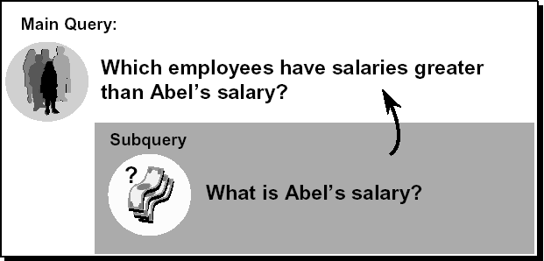
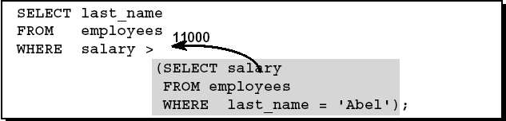
Example: Sub-queries

Slide 6
Sub-Queries Syntax
SELECT [ ALL | DISTINCT ]
[ TOP n [ PERCENT ] ]
* | {column_name | expression [alias],…}
FROM tableName
WHERE expression OPERATOR
(SELECT select_list
FROM table)
The subquery (inner query) executes once before the main query.
The result of the subquery is used by the main query (outer query).

Slide 7
1 – Subqueries that produce scalar values
An atomic value that can appear as one component of a tuple is referred to as a scalar.
Sometimes, a SELECT-FROM-WHERE expression produce only one scalar value:
  The salary of Abel
  The maximum Price of Products
If so, we can use this SELECT-FROM-WHERE expression, surrounded by parentheses, as if it were a constant

Slide 8
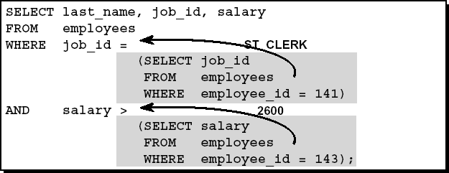

Example: Sub-queries that produce scalar values

Slide 9
2 – Conditions involving relations
There are a number of SQL operators that we can apply to a relation R and produce a boolean result:
  EXISTS R: is a condition that is true if and only if R is not empty
  s IN R: is true if and only if s is equal to one of the values in R
  s > ALL R: is true if and only if s is greater than every value in unary relation R
  s > ANY R: is true if and only if s is greater than at least one value in unary relation R
All the above operators can be negated by putting NOT in front of the entire expression

Slide 10
3 – Conditions involving tuples
A tuple in SQL is represented by a parenthesized list of scalar values
Exp:
  (123, ‘Foo’)
  (456,’Dump’)
  (name, address, networth)
If a tuple t has the same number of components as a relation R, then it makes sense to compare t and R in expressions involving IN, ALL, ANY operators

Slide 11
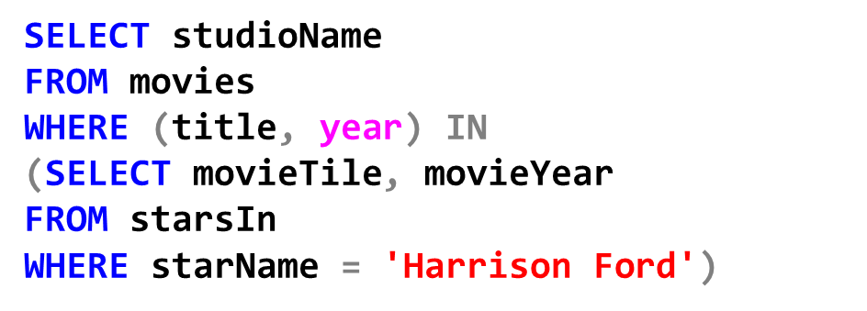
Example: Conditions involving tuples
movies(title,year, length, genre, studioName)
starsIn(movieTitle, movieYear, starName)
Find StudioName of movies for which ‘Harrison Ford’ played.
Note: You can not run the above code in SQL Server but in Oracle, DB2, MySQL

Slide 12
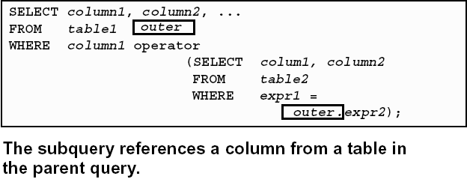
4 - Correlated Sub-Queries
A correlated subquery is one way of reading every row in a table and comparing values in each row against related data.
It is used whenever a sub-query must return a different result or set of results for each candidate row considered by the main query.

Slide 13
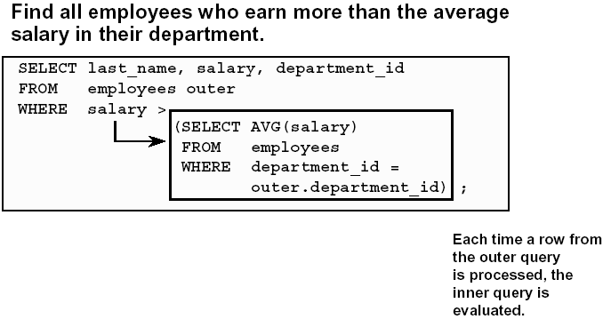
Example: Correlated Sub-queries

Slide 14
The differences between simple subqueries and correlated subqueries
The simple subqueries can be evaluated once and for all, and the result used in a higher-level query
A correlated subqueries require the subqueries to be evaluated many times, once for each assignment of a value to some term in the subqueries that come from a tuple variable outside the subqueries
So, you should avoid using correlated subqueries whenever possible

Slide 15
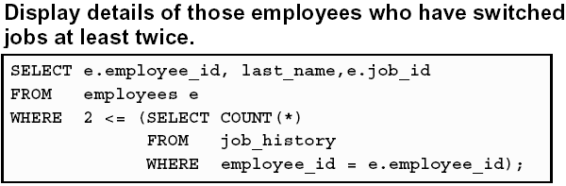
Example: Correlated Sub-queries

Slide 16
5 – Subqueries in FROM clauses
Another use for subqueries is as relations in a FROM clause:
SELECT name
FROM movieExec,
(SELECT producerC#
FROM movies, starsIn
WHERE title = movieTitle
AND year = movieYear
AND starName = ‘Harrison Ford’
) as Prod
WHERE cert# = Prod.producerC#

Slide 17
Thank You !

